Slide 1
Lesson 3 – Homework review

Slide 2
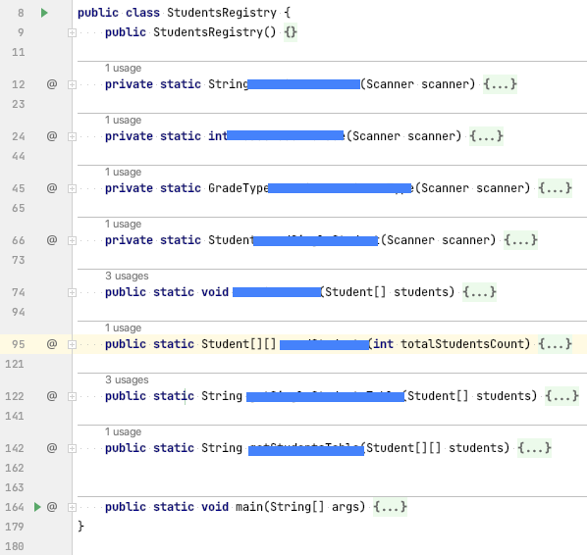
Single Responsibility (classes decomposition)

Slide 3
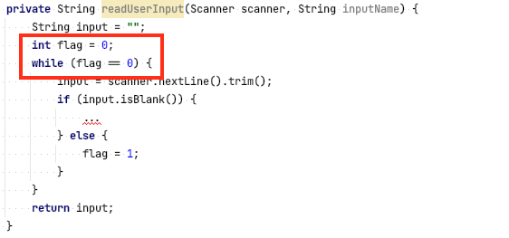
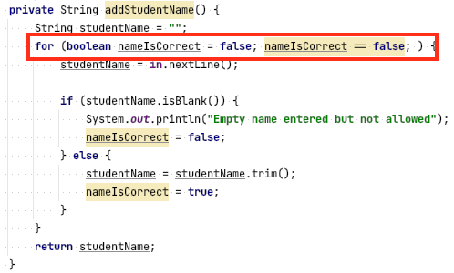
KISS - Keep It Simple Student

Slide 4
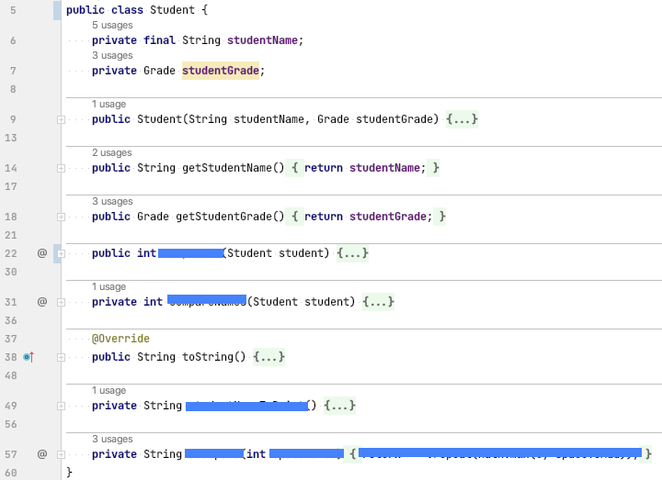
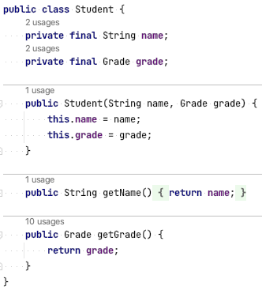
Simple POJO-s

Slide 5
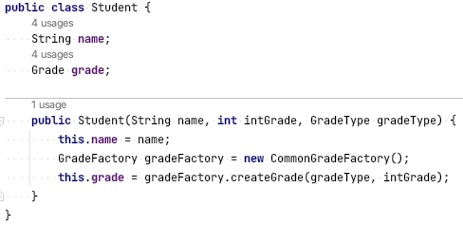
Performance Problem

Slide 6
Performance Problem (aka Redundand objects )

Slide 7
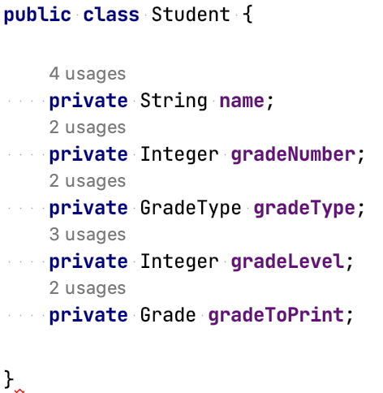
More about SRP

Slide 8
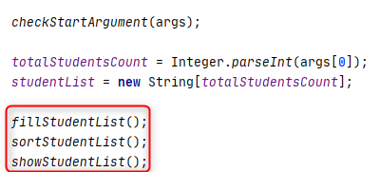

Prefer immutability

Slide 9
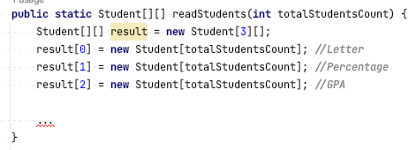
Avoid magic numbers

Slide 10
Avoid magic numbers

Slide 11
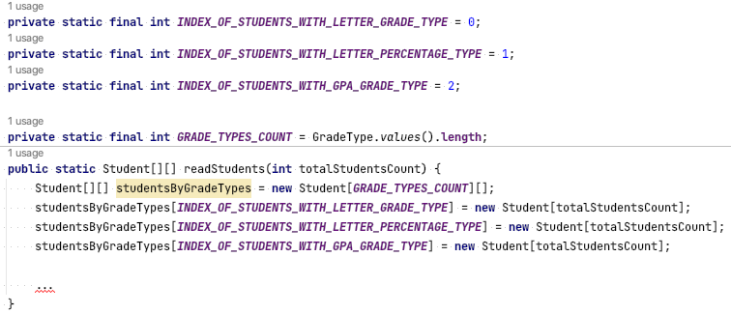
Avoid magic numbers

Slide 12
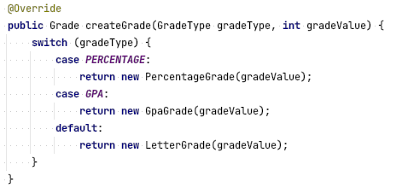
A defauult value for switch

Slide 13
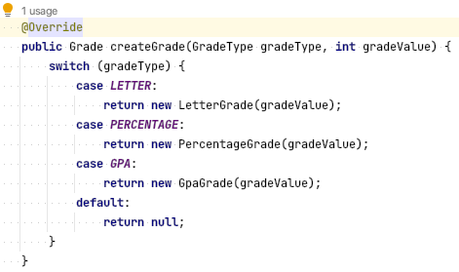
A defauult value for switch

Slide 14
Changed API contract
public interface Grade {
String asPrintVersion();
}
public interface Grade {
String asPrintVersion();
GradeType getType();
int getValue();
}

